Slide 1


Improving Rep Effectiveness in Today’s Market
Customer Value Metrics
Project Kick-Off
June 8, 2011
Prepared by IMS Health, Commercial Effectiveness Practice

Slide 2
Meeting Goals and Objectives
Introductions
Review high-level CVM process and project timeline
Identify Bayer-specific goals and objectives
Commence survey preparations
Confirm next steps
Bayer Oncology Customer Value Metrics Project Kick-Off • June 8, 2011
<number>

Slide 3
The program is implemented through a proven three-phased approach designed to assess SFE performance, implement improvement tactics and measure future gains
Phase 1:
SFE Research
and Analysis
Phase 2:
SFE Implementation
Phase 3:
SFE Impact
Assessment
12-14 weeks
4-6 weeks
9 months post Phase 2
Identify key SFE drivers
Develop and rollout improvement actions
Re-measure and identify change vs baseline
Survey design, fielding and data integration
Determine rep drivers of relationship and share
Assess baseline performance vs. internal and competitive benchmarks
  Prioritize metrics to improve, set targets for improvement
  Identify key opportunities and improvement tactics
  Design and develop improvement tools
  Guide delivery and roll-out
  Conduct follow-up research
  Report CVM results vs. baseline
  Assess impact on market share
Reevaluate opportunities and improvement tactics
This project focuses on Phase 1 & establishes the foundation for subsequent phases
Bayer Oncology Customer Value Metrics Project Kick-Off • June 8, 2011
<number>

Slide 4
Phase 1 approach – given August sales meetings we may share general results before completing the driver identification
Kick-off and
Survey Prep
Survey
Fielding
Driver
Identification
General &
Driver Results
Key Activities
Conduct kick-off meeting /workshops to identify and document Bayer-specific requirements
Create survey content and program for online use
Develop sample design based on target universe
Implement recruiting and optimize reminder efforts
QC and validate survey response data
Develop integrated dataset of survey results
Identify attributes that influence relationship and share
Analyze data and summarize results
Develop reports comparing Bayer performance to competitors on key – and all other – CVMs
Validate and vet findings through working sessions with Bayer
Bayer Input Needed
Current market dynamics/ Bayer ”hot buttons”
Target lists
Alignment files
Survey design input
Input into recruiting results
Key drivers and their predictive impact on share
Input into findings
Sample Output
Workshop summaries
Survey instrument
Weekly recruiting status summaries
Key drivers and their predictive impact on share
Performance metric summaries comparing Bayer performance with key competitors
Bayer Oncology Customer Value Metrics Project Kick-Off • June 8, 2011
<number>

Slide 5
Proposed project timeline
Kick-off and Survey Prep
Fielding
Results Summarization
6/6 | 6/13 | 6/20 | 6/27 | 7/4 | 7/11 | 7/18 | 7/25 | 8/1 | 8/8 | 8/15 | 8/22 | 8/29 | 9/5
Project Kick-off
Survey Creation
Bayer Sign-off on Survey
Survey Testing and Finalization
Fielding
Modelling & Results Summary
Interim Findings
Presentation
Final (Driver) Presentation
Bayer Oncology Customer Value Metrics Project Kick-Off • June 8, 2011
<number>

Slide 6
Discussion Topics
General Market Dynamics
Current Brand Initiatives
Ongoing sales efforts
  Re-alignments/changes
  Strategies, etc.
Milestone meetings
Bayer Oncology Customer Value Metrics Project Kick-Off • June 8, 2011
<number>

Slide 7
Project Inputs
Fielding Inputs
Disease State & Competitors
Sales force size
  5 RSMs; 36 Sales Consultants
  7 Market Development Specialists & 1 Hepatocellular Specialist
    7 Market Development Specialists and the 1 Hepatocellular Specialist work in the sales consultant's territories
Sales force geographies
  5 Regions
  36 territories
Targets – 100-125 per territory
Goal of 300 responses – 60 completes per region
Recruiting quotas?
Disease State:
  “Advanced renal cell carcinoma” (RCC)
Competitive Set
  Bayer: Nexavar (sorafenib)
  Pfizer: Sutent (sunitinib); Torisel (temsirolimus)
  Novartis: Afinitor (everolimus)
  GSK: Votrient (pazopanib)
  Genentech: Avastin (bevacizumab)
Bayer Oncology Customer Value Metrics Project Kick-Off • June 8, 2011
<number>

Slide 8
Target List – Data elements
Excel-based output should include:
  Physician name and address information
    Also fax number and email addresses as available
  Identifiers (ME, IMSID, AMA number, etc.)
  Specialty
  Sales force information (territory/district, area, etc.)
  Other elements
    Call information
    Segments
    Rx Volume
    Coupons
    Other
Bayer Oncology Customer Value Metrics Project Kick-Off • June 8, 2011
<number>

Slide 9
Proposed Survey Outline
Part I: Background & Qualifiers
Part II: Evaluation of Sales Forces (CVMs)
Part III: Views about Relationships With Reps/Other
  Typically open ended - optional
Bayer Oncology Customer Value Metrics Project Kick-Off • June 8, 2011
<number>

Slide 10
Part 1: Background and Qualification
Decision: confirm Specialties
Decision: Qualifier or segmentation purposes only
Please answer the following questions about yourself and your practice.
1. What is your primary specialty?
  (Use a drop down menu of Oncology, Nephrology, Internal Medicine, Other)
2. In which state is your primary office located?
  (Use a drop down menu of states)
3. What is the zip code of your primary office?
  (Enable fill-in)
4. How many years have you been in practice?
  (Enable fill-in)
5. Are you in a group practice or do you operate independently?
  (Use a drop down menu)
6. Which of these companies that offer treatments for XXX did you personally interact with (receive sales calls) in the last 6 months? For your reference, their products are also provided.
(If respondent does not check Bayer and 1 or more other boxes, terminate)
Needed for Primary Market Research purposes, typically not used for assignments to sales geographies
Segmentation purposes; not a disqualifier
Typically for segmentation purposes; not a disqualifier
Confirm disease state
Confirm timing (qualifier)
Confirm number of companies seen as qualifier
Any other quotas
Bayer Oncology Customer Value Metrics Project Kick-Off • June 8, 2011
<number>

Slide 11
Part 2: Sales Force Attributes (CVMs)
Part 2: Your Rating of Sales Forces That Visit You (CVMs)
In this section, you will be asked questions about the pharmaceutical company sales forces that visit you. Some of these companies send one representative; other companies send multiple representatives. We would like you to respond by thinking of each company’s sales force, whether this is one or multiple representatives.
  Please rate the effectiveness of each company’s sales force, using the following scale from 1 to 9…:
    (Provide list of companies selected from Part 1)
Bayer Oncology Customer Value Metrics Project Kick-Off • June 8, 2011
<number>

Slide 12
CVMs typically fall under one of five rep characteristics
Knowledge and Information Exchange
Expert Rep: An objective, unbiased product and disease state expert who understands their Disease State holistically
Practice and Office Support
Servicer Rep: Non-aggressive but highly present and responsive servicer who resources the practice (physician and staff)
Improving Patient Outcomes
Consultant Rep: A consultant who is primarily focused on improving patient outcomes
Prescribing Barriers
Patient Advocate Rep: A patient advocate and teacher who works at helping the practice improve patient outcomes (e.g., lower patient costs, reimbursement etc.)
Rep Behavior & Interaction Style
Interactive Rep: An interactive rep assesses doctor attitudes and behaviors and modulates his/her messages and interactions according
Bayer Oncology Customer Value Metrics Project Kick-Off • June 8, 2011
<number>

Slide 13
Sample attributes for qualifying behaviors and attributes for “Expert” reps
Knowledge and Information Exchange
1 | Answers my product related questions effectively
2 | Communicates differences between products used to treat [Disease State] and related complications
3 | Discusses ways to minimize potential product side effects
4 | Explains safety information for drugs that I am less familiar with
5 | Explains the benefits of using a branded product over a generic in [Disease State] and related complications
6 | Explains the potential for side effects or drug interactions
7 | Is a helpful source of information for considering treatment options
8 | Is a valuable source of continuing education information (e.g., journal articles, reprints, links to web-based resources)
9 | Shares information about treatment preferences of peers in my area of practice
10 | Updates me on new information about products, such as clinical trials, case studies, or news about new products
11 | Uses comprehensive knowledge of [Disease State] to make conversations interesting
12 | Demonstrates in-depth knowledge of competitor products
13 | Demonstrates in-depth knowledge of his/her product(s)
14 | Has an appropriate balance of company developed materials vs. clinical reprints
15 | Is knowledgeable about ongoing clinical trials
16 | Possesses a medical/science background
17 | Understands and presents clinical studies in an effective manner
Bayer Oncology Customer Value Metrics Project Kick-Off • June 8, 2011
<number>

Slide 14
Sample attributes for qualifying behaviors and attributes for “Service” reps
Practice and Office Support
1 | Provides me with valuable networking opportunities that connect me to leading experts
2 | Provides my practice with helpful patient education materials
3 | Provides resources to help my office and patients with reimbursement needs
4 | Keeps me informed about his/her company's consumer advertising efforts
5 | Keeps me informed of speaker programs that I am interested in
6 | Offers opportunities to help build referring networks
7 | Offers resources that support my professional, practice, or business interests
8 | Regularly informs me of his/her company’s resources available to me and my staff
9 | Serves as a resource to help my office staff operate efficiently
10 | Understands and responds to the unique needs of my practice, such as customizing information for the type of patients I treat
11 | Does not attempt to place more samples in my office than what is needed
14 | Helps me identify appropriate patients for his/her drug
15 | Invites me to relevant medical events
16 | Is a valuable resource in helping my office staff navigate prior authorizations
17 | Is sensitive to my office's time constraints
19 | Provides my practice with helpful, brand-specific patient education materials
20 | Supports my practice by observing office policies and being discreet in his/her interactions with me and my staff
21 | Turns around requests from me in a timely manner
Bayer Oncology Customer Value Metrics Project Kick-Off • June 8, 2011
<number>

Slide 15
Sample attributes for qualifying behaviors and attributes for “Consultant” reps
Improving Patient Outcomes
1 | Is a valuable source of information about treatment strategies for hard-to-treat patients
2 | Keep me informed about the company’s patient assistance program, enabling me to prescribe the product for more patients
3 | Provides useful information to help me deal with patient concerns or complaints
4 | Serves as a valuable resource in understanding treatment options for different types of patients
5 | Explains why his or her drug is appropriate for certain patients, such as pregnant patients
6 | Provides me with resources to assist my patients in initiating therapy
7 | Serves as an effective consultant in improving patient compliance
8 | Demonstrates a genuine interest in improving patient care
9 | Is a valuable resource in helping me achieve better patient outcomes
10 | Provides tools & resources that improve the quality of patient care
Bayer Oncology Customer Value Metrics Project Kick-Off • June 8, 2011
<number>

Slide 16
Sample attributes for qualifying behaviors and attributes for “Patient Advocate” reps
Prescribing Barriers
1 | Keeps me apprised of the patient’s out of pocket cost (co-pay rate) for his or her product
2 | Provides information to help me optimize dosing
3 | Provides me with tools / information to make me feel confident in making new treatment decisions (switching therapy or new patient starts)
4 | Keeps me informed of the reimbursement situation for products, so I can factor cost into my prescribing decision
5 | Effectively answers my reimbursement questions about his/her product(s)
Bayer Oncology Customer Value Metrics Project Kick-Off • June 8, 2011
<number>

Slide 17
Sample attributes for qualifying behaviors and attributes for “Interactive” reps
Rep Behavior and Interaction Style
1 | Adjusts his or her interactions to how much time I have available
2 | Overall, the rep builds a professional relationship that I value
3 | Takes an objective, unbiased approach when discussing products
4 | Varies the product message according to my practice needs
5 | The company builds relationship by keeping the same rep visiting my office over a long time period
6 | Behaves ethically
7 | Has an engaging style of interaction and is personable
8 | Engages me in meaningful dialogue about his/her product relative to competitive products
9 | Engages me with clinically impactful dialogue
10 | Has a professional manner
11 | Makes adequate use of pre-scheduled meetings to foster more focused discussions
12 | Creates an environment of candor
13 | Seeks to understand my reasons for prescribing drugs
14 | Takes time to know the medical events of interest to me
15 | Understands my professional goals
Bayer Oncology Customer Value Metrics Project Kick-Off • June 8, 2011
<number>

Slide 18
Part 3 – Open Ended Questions (optional)
Identifying stronger performers
  “What does the rep with whom you have the best relationship do differently than his/her competitors?”
  “In your opinion, what enables this rep to better meet your needs/interests?”
  “What should reps do to enable you to prescribe their product more often?”
Bayer Oncology Customer Value Metrics Project Kick-Off • June 8, 2011
<number>

Slide 19
Next Steps
Incorporate input from this session into survey
Schedule next meeting
Bayer Oncology Customer Value Metrics Project Kick-Off • June 8, 2011
<number>

Slide 20

Appendix
Bayer Oncology Customer Value Metrics Project Kick-Off • June 8, 2011
<number>

Slide 21
According to health care providers, deeper relationships with fewer representatives will be the future
Rep of the Future
Reps with these capabilities will win share of relationship:
Rep as knowledge resource
Rep as company resource
Rep as patient resource
An objective, “unbiased” method of communicating product and therapy area differences
Depth and ability to answer specific questions about the product, product class, and disease
Ability to share the broader treatment patterns / KOL thinking
Information about patients suffering from the disease, and ways to help identify more optimal therapy
Ability to connect the practice to company resources
Bayer Oncology Customer Value Metrics Project Kick-Off • June 8, 2011
<number>
Notes:
Talked about the Rep vision of the future that we see and how closely aligned that is with Bayers vision

Slide 22

Kickoff and workshop
Kickoff
Survey
Prep
Field
Drivers
Results
Activities
Interview key/relevant Bayer stakeholders
Conduct kick-off meeting and strategy workshop to:
  Define success criteria and over-arching project objectives
  Align stakeholders around key project challenges, opportunities and needs
Deliverables
Detailed project plan and future team meeting calendar
Workshop meeting minutes, capturing:
  Key challenges/risks specific to Bayer
  Criteria for success and specific business objectives
Roles and Responsibilities
IMS
Develop interview templates
Develop workshop materials
Facilitate workshop
Bayer
Allocate time of key stakeholders
Accelerators: Large program and strategy through implementation experience; Workshop facilitation experience
Bayer Oncology Customer Value Metrics Project Kick-Off • June 8, 2011
<number>

Slide 23
Survey and Analytics Design
Kickoff
Survey
Prep
Field
Drivers
Results
Activities
Conduct workshop to refine attributes and customize per Bayer requirements
Program survey
Develop sample design based on Bayer’s target universe
Deliverables
Survey instrument (15 – 20 minutes in length)
Sampling methodology, specifying sample quotas by specialty and geography
Recruiting lists for each chosen specialty
Roles and Responsibilities
IMS
Provide baseline attributes for evaluation
Survey testing and implementation
Sample design
Bayer
Provide input and customer target/ alignment data for sampling design
Accelerators: Library of validated CVM attributes; Survey templates and on-line web surveys; Workshop presentations; data file specifications
Bayer Oncology Customer Value Metrics Project Kick-Off • June 8, 2011
<number>
Notes:
PUT VALUE to Bayer STATEMENTS HERE..

Slide 24
Field and Data Integration
Kick-off
Survey
Prep
Field
Drivers
Results
Activities
Implement recruiting and optimize reminder efforts
Conduct weekly status meetings to provide update on fielding performance
QC and validate survey response data
Develop integrated data set of survey results to enable modelling
Deliverables
Weekly status report
Integrated data set, including survey responses provided in SAS or Excel
Roles and Responsibilities
IMS
Manage 3rd party vendor to optimize recruiting efforts
Perform data analysis and quality control on primary data
Accelerators: Experience recruiting ~25,000 Physicians for CVM programs across various specialties and therapy areas; Data integration platforms and experience
Bayer Oncology Customer Value Metrics Project Kick-Off • June 8, 2011
<number>

Slide 25
Identify Relationship and Share Drivers
Kickoff
Survey
Prep
Field
Drivers
Results
Activities
Integrate primary data with prescription data
Identify attributes that are most likely to influence relationship and share through regression modelling
Deliverables
Key share drivers and their predictive impact on share and dollars for the franchise nationally
Key relationship drivers that are most likely to influence the Rep-Prescriber relationship
Roles and Responsibilities
IMS
Statistical modelling to identify key value metrics
Recommendation on key attributes
Bayer
Feedback and approval on key attributes
Accelerators: Prescription data and modeling experience; Experience with selection of key attributes across numerous therapy areas
Bayer Oncology Customer Value Metrics Project Kick-Off • June 8, 2011
<number>

Slide 26
To select the most important attributes, we analyze both relationship and market share models
Kickoff
Survey
Prep
Field
Drivers
Results
Factors that drive relationship and market share are the key to gaining a competitive advantage
Variables that drive market share
Variables that build relationship
Drive Relationship & Share
Factors causal to both relationship and market share are determined through statistical modeling
Typically, 3-5 variables are selected based on regression analysis from a universe of 30-40 Customer Value Metrics
Improving performance in the top attributes will provide long-term selling advantage
Bayer Oncology Customer Value Metrics Project Kick-Off • June 8, 2011
<number>

Slide 27
Report CVM Baseline Results
Kickoff
Survey
Prep
Field
Drivers
Results
Activities
Analyze data and gather insights
Develop national and geo level reports comparing Bayer performance to competitors on key CVM metrics
Gather additional insights from remaining attributes
Develop insights and recommendations for improving key attributes
Deliverables
Performance metrics comparing your scores with key competitors
Working session to review results and determine whether to proceed to implementation
Recommended actions to improve sales force effectiveness
Roles and Responsibilities
IMS
Analysis of data and results creation
Communicate results to Bayer internal teams
Accelerators: Automated analysis and presentation generators; Experience interpreting result sets
Bayer Oncology Customer Value Metrics Project Kick-Off • June 8, 2011
<number>

Slide 28
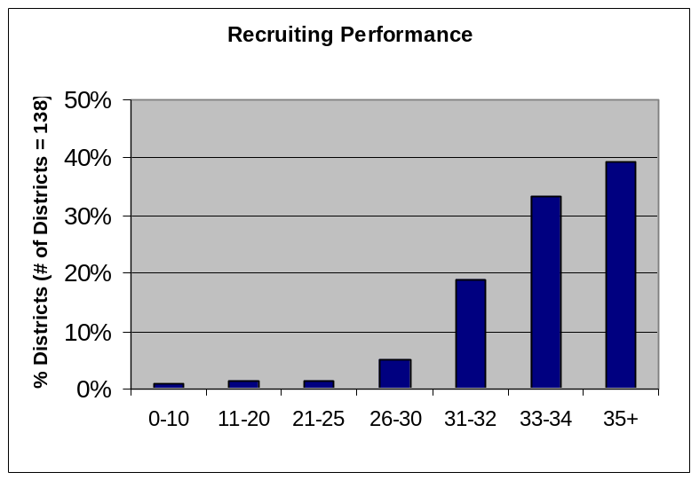
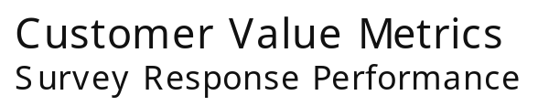
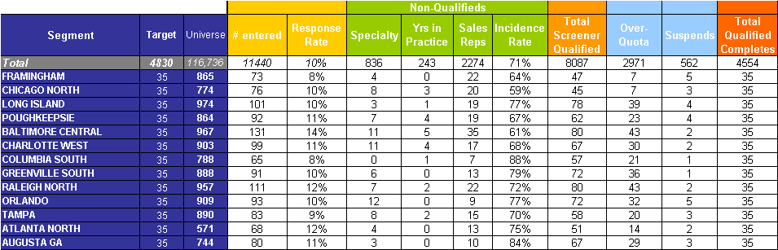
Research Management Sample Deliverable
Kickoff
Survey
Prep
Field
Drivers
Results
We manage each step of the recruiting process with tools/reports we have developed to ensure optimal output from fielding
Required n=35 per district.
Distribution of geographies after 2 (out of total of 5) weeks in field
Bayer Oncology Customer Value Metrics Project Kick-Off • June 8, 2011
<number>

Slide 29
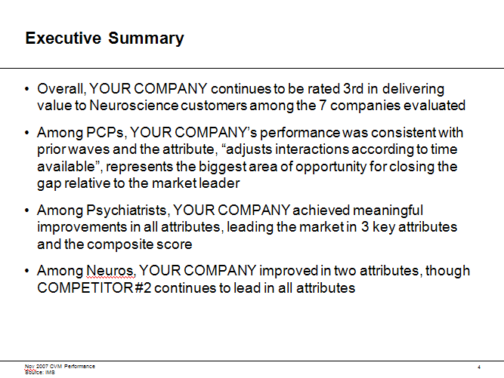
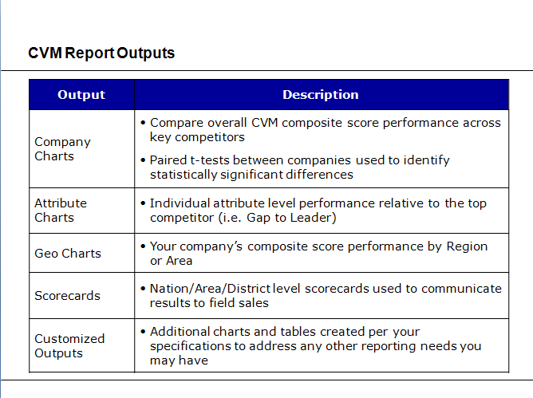
Our final report includes a summary of key findings and comprehensive set of charts that help Bayer assess results and decide on appropriate actions
Kickoff
Survey
Prep
Field
Drivers
Results
Illustrative
Bayer Oncology Customer Value Metrics Project Kick-Off • June 8, 2011
<number>

Slide 30
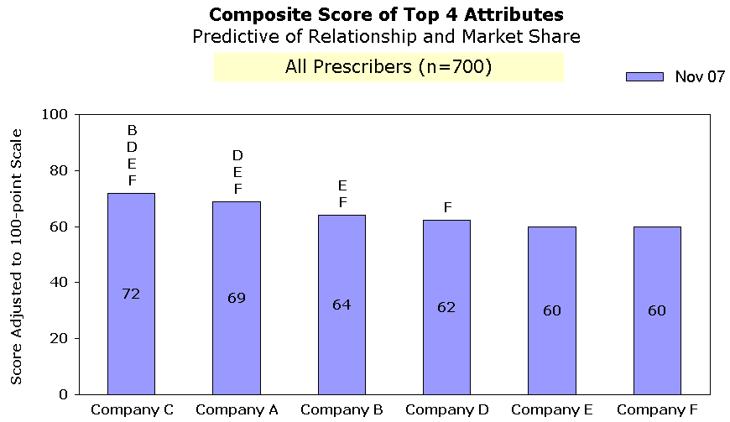
The chart below includes overall composite score performance for each competitor, showing which scores are statistically different
Kickoff
Survey
Prep
Field
Drivers
Results
Notes:
The initial of the company indicates a statistically significant difference in performance
Statistical significance is tested at the 90% confidence level (p<0.10)
Bayer Oncology Customer Value Metrics Project Kick-Off • June 8, 2011
<number>

Slide 31
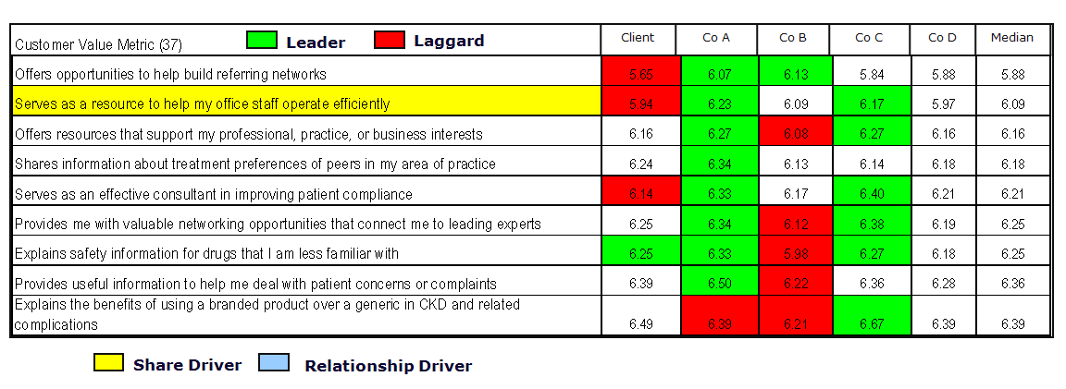
Sample Results Output – Company Comparison by CVM
Kickoff
Survey
Prep
Field
Drivers
Results
Bayer Oncology Customer Value Metrics Project Kick-Off • June 8, 2011
<number>

Slide 32
In Phase 2, we select key CVM drivers and identify options for improvement
Strategy
Roadmap
Activities
Workshop to re-introduce the program objectives and select key CVM drivers to invest in that impact share and/or relationship
Brainstorm initiatives to increase customer value that fits with current commercial objectives/structure
Deliverables
Clarified and documented set of CVM share/relationship drivers to focus initiative investments
List of potential initiatives for investment in-line with the selected drivers
Roles and Responsibilities
IMS
Develop the workshop materials and facilitate/provide input for the workshop
Bayer
Provide input on the organization’s desire to pursue different CVM drivers and provide input on brainstorming
Accelerators: Prior workshop, CVM, and strategy program management experience
Bayer Oncology Customer Value Metrics Project Kick-Off • June 8, 2011
<number>
Notes:
PUT VALUE to Bayer STATEMENTS HERE..

Slide 33
Develop Initiatives & Implementation Roadmap
Strategy
Roadmap
Activities
Obtain input from Bayer management on the preferred organizational approach, including assignment of initiative ownership
Define initiatives steps
Working session with Bayer management to propose an investment plan and implementation roadmap
Deliverables
Documented initiative scope, timeline, and approach with clear Bayer ownership
Implementation roadmap at the program level for tracking
Roles and Responsibilities
IMS
Develop the workshop materials and facilitate/provide input for the workshop
Bayer
Provide input on the organizational approach; Assign resources for initiatives
Accelerators: Prior workshop, CVM, and strategy program management experience; Templates for initiative definition, roadmap development, etc.
Bayer Oncology Customer Value Metrics Project Kick-Off • June 8, 2011
<number>
Notes:
PUT VALUE to Bayer STATEMENTS HERE..

